Slide 1
Modular User Interfaces
A better Framework
Fahim Farook

Slide 2
Agenda
Defining ‘Modularity’
A case study - Gmail
Client-side solution – a Framework
Demo

Slide 3
Agenda
Defining ‘Modularity’
A case study - Gmail
Client-side solution – a Framework
Demo

Slide 4
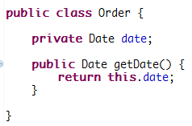
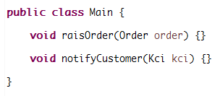
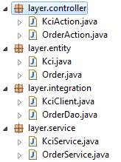
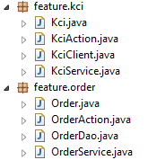
Modules are Highly cohesive and Loosely coupled ‘units’
Reduced complexity
Increased maintainability
Increased reusability
Notes:
Overloaded term - depending on the context – different meanings.
Java - A "module" might be analogous to a Java class, or a Java package.
Package by feature vs package by layer
Package by feature is more modular
→ If you take a single package – classes are focused on one business sub-domain/ feature
→ Classes in a package have minimal coupling with other packages.
Modular means
Highly cohesive → Provides a specific feature - Units which does one thing
As a result they are decoupled from other modules
Advantages
Increased reusability – you could package ‘order’ in a jar and reuse
Reduced complexity – bcz having fewer operation, less integration with rest of the world
Increased maintainability – adding or removing modules have minimum system impact

Slide 5
Keywords
DOTADIW
Single Responsibility
Focused
High Cohesion
Low Coupling
Divide and Conquer
Simple/ Not-complex
Reusable
Maintainable
Self contained
Easy Navigation
Notes:
Some word which will give you sense of ‘modularity’

Slide 6
How about JavaScript?

Slide 7
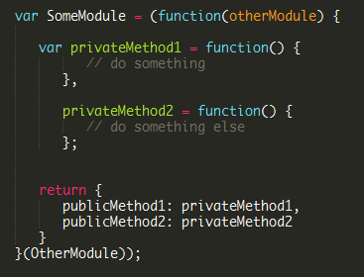
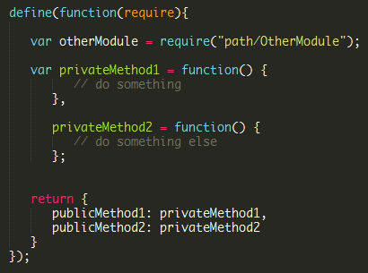
With IIFE
AMD
Notes:
Module is a design pattern
Analogous to Class or Object

Slide 8
What about ‘Modular UI’ then?
Notes:
What are the things the UI is composed of?
JavaScript
HTML
CSS
Assets (Images/ Fonts etc.)
All these things should be modular for a UI to be modular.

Slide 9
Agenda
Defining ‘Modularity’
A case study - Gmail
Client-side solution – a Framework
Demo
Notes:
Let’s begin our journey towards the Framework.
This Framework solves some problems – let’s first understand what are the problems it is going to solve.

Slide 10
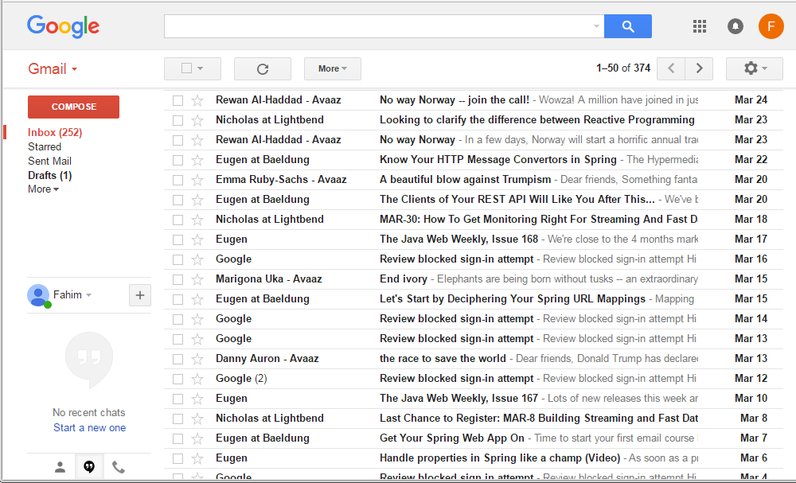
Notes:
Is it modular?

Slide 11
Header
Folders
Mail List
Chat
Notes:
What are the business capabilities does this UI have?
In any UI, the page layout resembles the business capabilities
Layout has distinct areas for different features.
Let’s call them modules.
And the modules have to communicate with each other.

Slide 12
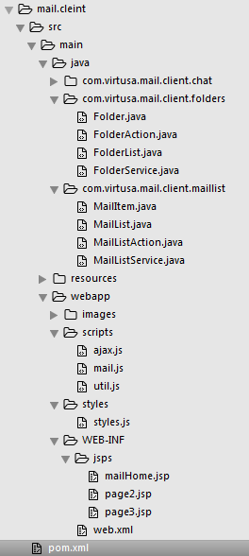

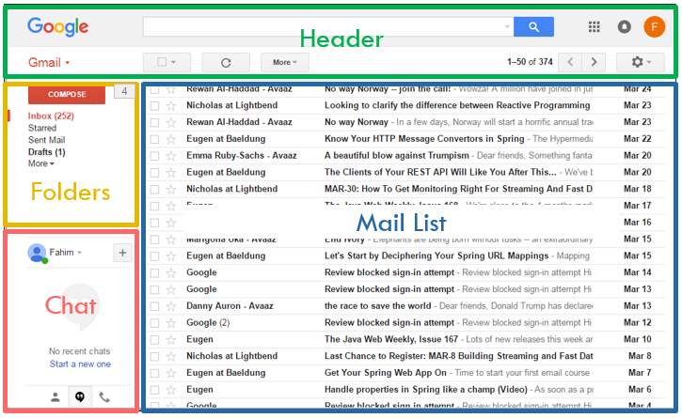



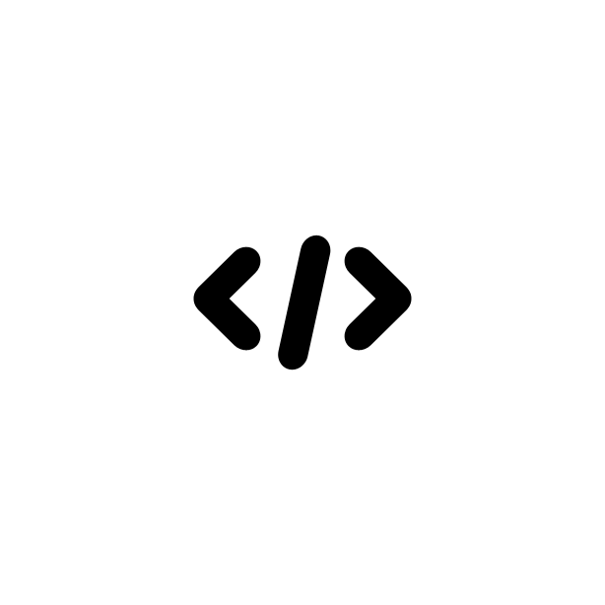
Solution Structure
Notes:
First thoughts on Gmail project – maven webapp with JSP, css and JS ☺
Problem with the solution structure
Having both server side and client side technologies
Java and UI engineers both have to work in a single project
What's the big deal?
Web content deployed on servlet container

Slide 13
Issue 1 – No separation of technology concerns

Slide 14
Solution 1 – Let’s separate the technology concerns

Slide 15
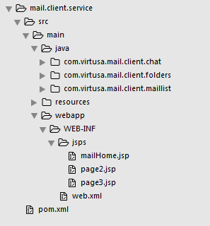
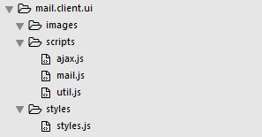

Notes:
Why single JSP is bad?
Cannot reuse
Complex
All those non-modularity issues

Slide 16
Issue 2 – Single JSP to rule them all

Slide 17
Solution 2 – Tiles to rescue
Notes:
Apache Tiles Framework

Slide 18
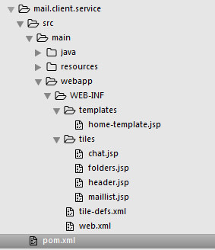
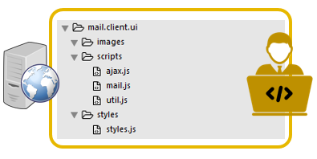
Notes:
Using Apache tiles – decompose the mailHome.jsp into ‘modules’

Slide 19
Let’s revisit the web contents

Slide 20
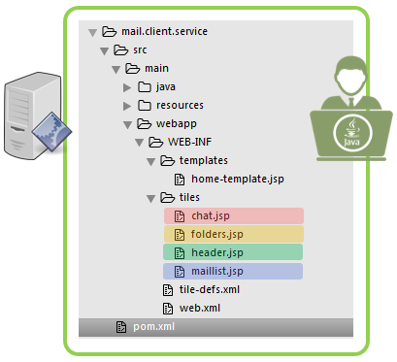
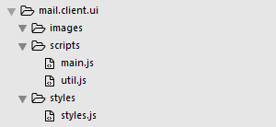
Notes:
JavaScript is reusable?
How much of JS/ CSS/ HTML are dependent on each other?
HTML is on a separate project
Change in chat function may affect inbox – bcz both are in a single JS file.
What if functions related to mailbox fail? Other parts continue to work?

Slide 21
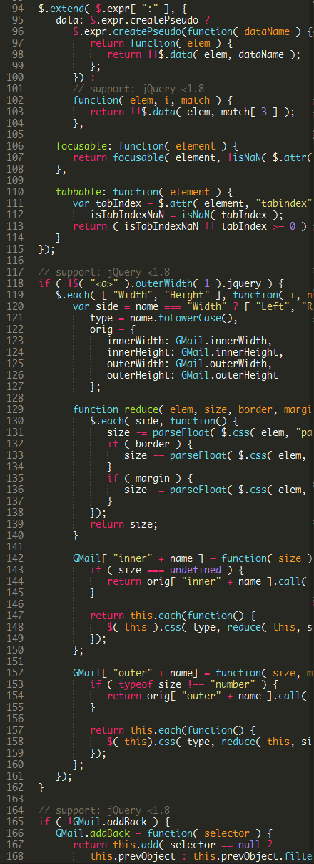
Issue 3 – Long JavaScript files (& functions)
Not coherent
Violates SRP
Encourages developing pages
Not reusable
High complexity

Slide 22
Issue 4 – Tight coupling
When one function fails, rest of the system fails
Difficult to test in isolation
Cannot introduce a new feature (without modifying existing code)
High complexity
Main.js
Util.js
This.js
That.js

Slide 23
Issue 5 – Polluted DOM
Same portion of the DOM is updated by multiple JS files
DOM is in race condition?
That.js
Main.js

Slide 24


Issue 6 – Vendor Lock
$(‘.element’).function();
$(‘.element’).function();
$(‘.element’).function();
$(‘.element’).function();
$(‘.element’).function();
$(‘.element’).function();
$(‘.element’).function();
$(‘.element’).function();
$(‘.element’).function();
$(‘.element’).function();
$(‘.element’).function();
$(‘.element’).function();
Tight coupling with libraries
Moving from jQuery to dojo is nearly impossible
Rewriting the entire application?
Main.js

Slide 25
Solution 3, 4, 5, 6
Let’s build a Framework

Slide 26
Back to Tiles
Notes:
http://tiles.apache.org/2.2/framework/tutorial/pattern.html

Slide 27
Notes:
What's the problem with tiles (i.e. server side templating)

Slide 28
Issue 7 – Server side view technology (JSP)
Java + HTML
Requires compilation
Cannot reuse prototype
UI guys to setup application servers to look into UI issues

Slide 29
Solution 7
Let’s build the Framework

Slide 30
Agenda
Defining ‘Modularity’
A case study - Gmail
Client-side solution – a Framework
Demo

Slide 31
Design Goals
Modular / coherent front-end component
Loosely coupled JavaScript modules
Reduce complexity of the overall application
Application architecture to be independent of the technology
Safe DOM
A centralized error handling mechanism
Utilities – Logging, argument validation
Extendibility via plugins
Notes:
Developers develop/ focus on modules, not whole pages

Slide 32
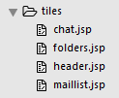

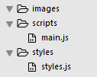

Self contained UI Components
Header
Header
Folder
Mail List
Folder
Mail List
Reusable UI components composed of
JavaScript
Html
Css
Images
all in one directory
Notes:
Package by feature (i.e. like header package, folder package…)
- Compare with Java packages

Slide 33
Safe DOM
Header
DOM Gateway
Folder
Mail List
Modules are not allowed to access the DOM outside it’s ‘domain’

Slide 34
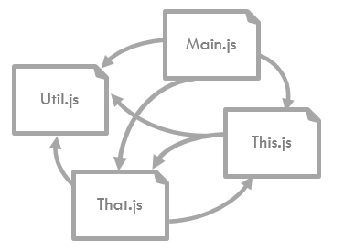
No Module Coupling
Module 1
Facade
PUBLISH X
Not allowed
Kernel
Module 2
SUBSCRIBE X
Facade
Module 3
Facade
SUBSCRIBE X
Modules communicate via an injected façade – no modules call each other directly – hence decoupled
Notes:
Façade – why - To hide complexities/ abstraction
Allows creating plugins/ Aspects/ decorators
Pub/ Sub - messaging
System decupling
Compare with Unix
Kernel – core
Intercrosses communication – via signals
Kernel API – system calls API.

Slide 35
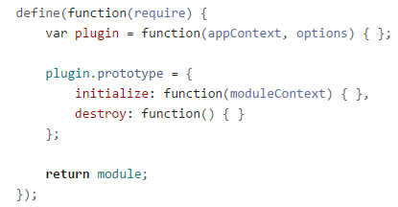
Extensibility
Module
Application → with modules
Framework → with Plugins
Security
Template
HTTP
FSM
Notes:
Once you developed a module – it should be reusable. Drop it in a new page and it should just work.

Slide 36
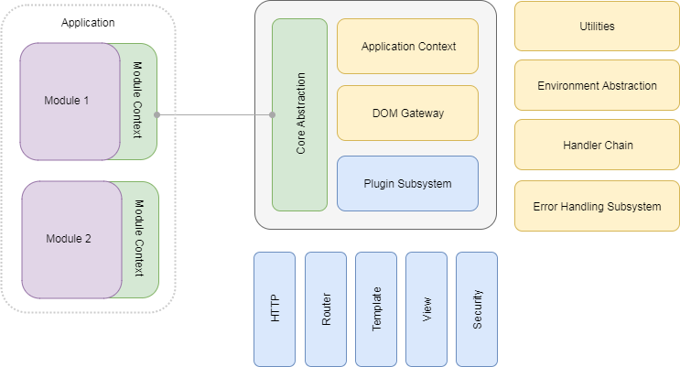
Design

Slide 37
What else?
Scaffolding
Widgets
Integration – Mustache, React etc.
Bower compliant components

Slide 38
Demo

Slide 39
A Framework to solve ‘em all?
Notes:
This framework does not solve all your UI concerns.
It provides architectural / programming model at the application level. You are still responsible for the individual modules.
Spending enough time planning out your modules is a must.

Slide 40
Thank you!

